Slide 1

Term 2 Project - Tableau
Global Trade Analysis
By:
Siddhant Puranik
PGD - Data Science

Slide 2
Contents
Overview of the project
Data Description
Data Preparation
Learning
Insights

Slide 3
Overview of the project
The objective of the project was to create innovative and interactive Tableau dashboards that focus on potential commodities, countries, year, trade amount and quantity.
The client wanted to launch a new business unit, focusing on global trade and logistics, majorly in the countries such as USA, Canada and Australia
The dataset provided by the client contained 59090 observations of 10 variables.
The client insisted the data to be cleaned using Excel or R. The Dataset contained missing values and was cleaned using the R programming language.
Tableau dashboards were created from the cleaned dataset.

Slide 4
Data Description
Variable | Description
Country or Area | There were three countries – Australia, Canada, and the USA
Year | The Year variable ranged from 1988 to 2016
Commodity Code | The commodity code was unique for each commodity. Example: 10111 for Horses, live pure bred
Commodity | The commodity variable contained various trade commodities that belonged to each of the 12 categories.
Flow | This indicates flow of trade. They are Export, Import, Re-Import, and Re-Export.
Trade USD | The trade value in US Dollars
Weight | The total weight of the traded commodity in Kgs
Quantity Name | Quantity name of the traded commodity
Quantity | The total quantity of the traded commodity
Category | There were 12 unique categories in the data.

Slide 5
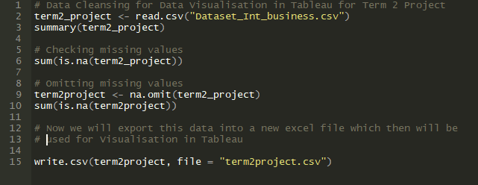
Data Preparation
The data was cleaned using the R programming language.
Upon exploring the dataset, it was found that the weight and the quantity variable contained missing values. Additionally, there were “0” values in these variables. But since there was trade amount associated with them I have considered that trade amount.
The data was cleaned and the missing values were omitted.

Slide 6
Insights
After importing the data in Tableau, and studying the data visually, I was able to derive the following insights:
Insights derived
From 1988 to 2016, the USA has been the largest exporter, importer, and re-exporter of commodities. Whereas Canada has been the largest re-importer of commodities. The USA has never re-imported commodities throughout these years. Australia hasn't re-exported commodities since the year 2000. Canada began re-exporting commodities from the year 2000. In the year 2016, Canada was the largest re-exporter of commodities. Canada dominates the re-import trade business. Top categories were identified for each country. Trade Balance was calculated and analysed. It was observed that all the countries had Trade Surplus from 1988 to 2016. The countries were ranked based on this observation. It is believed that a Trade Surplus country isn’t suitable for import business. Top Commodities were identified based on their quantity traded via export, import, re-export, and re-import.

Slide 7
Thank You
Visit my Tableau Public profile to view this project:
https://public.tableau.com/profile/siddhant.puranik#!/

